Slide 1

Unit 03.04.01 CS 5220: COMPUTER COMMUNICATIONS
Packet level – Scheduling and QoS
XIAOBO ZHOU, Ph.D.
Professor, Department of Computer Science

Slide 2
Time Scales & Granularities
Packet Level
Queueing & scheduling at multiplexing points
Determines relative performance offered to packets over a short time scale (microseconds)
Flow Level
Management of traffic flows & resource allocation to ensure delivery of QoS (milliseconds to seconds)
Matching traffic flows to resources available; congestion control
Flow-Aggregate Level
Routing of aggregate traffic flows across the network for efficient utilization of resources & meeting of service levels
“Traffic Engineering”, at scale of minutes to days
Notes:
Granularity: the scale or level of detail present in a set of data or other phenomenon.

Slide 3
End-to-End QoS
Packet buffer
…
1
2
N – 1
N
A packet traversing network encounters delay and possible loss at various multiplexing points
End-to-end performance is accumulation of per-hop performances
Packet loss occurs when no more buffer available for a packet

Slide 4
Scheduling & QoS
End-to-End QoS & Resource Control
Buffer & bandwidth control → Performance
Admission control to regulate traffic level
Scheduling Concepts
Fairness, isolation, priority, aggregation,
Fair Queueing & Variations
FQ/WFQ, PGPS
Guaranteed Service
FQ/WFQ, Rate-control
Packet Dropping
Notes:
Packet switch networks need to support a wide range of service,
with diverse quality of service requirements.
A queuing system must implement strategies for controlling the transmissions bit rates
that are provided to information flows called queue scheduling.
Factors considered in scheduling include fairness, priority, and isolation.
Buffer management is also needed for managing how packets are placed in the system.

Slide 5
FIFO Queueing
Packet buffer
Arriving
packets
Transmission
link
Packet discard
when full
All packet flows share the same buffer
Transmission Discipline: First-In, First-Out
Buffering Discipline: Discard arriving packets if buffer is full (Alternative: random discard; pushout head-of-line, etc.)
Delay and loss depends on inter-arrival time and packet lengths

Slide 6
FIFO Queueing
Cannot provide differential QoS to packet flows
Different packet flows interact strongly
Statistical delay guarantees via load control
Restrict number of flows allowed (admission control)
Difficult to determine performance delivered
Finite buffer determines a maximum possible delay
Buffer size determines loss probability
But depends on arrival & packet length statistics

Slide 7
FIFO w/o and w/ Discard Priority
(a)
Packet buffer
Arriving
packets
FIFO queueing
FIFO queueing
with discard priority
Transmission
link
Packet discard
when full
(b)
Packet buffer
Arriving
packets
Transmission
link
Class 1
discard
when full
Class 2 discard
when threshold
exceeded
Notes:
The FIFO queue management can be modified to provide a different characteristics of packet and loss performance to different classes of traffic.
Packets of low access quality will experience a higher packet loss probability, so performance differentiation is provided.

Slide 8
HOL Priority Queueing
Packet discard
when full
Transmission
link
High-priority
packets
Low-priority
packets
When
high-priority
queue empty
Packet discard
when full
High priority queue serviced until empty
High priority queue has lower waiting time
Buffers can be dimensioned for different loss probabilities

Slide 9
Summary: HOL Priority Features
(Note: Need labeling)
Provides differential QoS
High-priority classes can hog all of the bandwidth & starve lower priority classes
Need to provide some isolation between classes
Delay
Per-class loads

Slide 10
Unit 03.04.02 CS 5220: COMPUTER COMMUNICATIONS
Packet Level: Fair Queuing and RED
XIAOBO ZHOU, Ph.D.
Professor, Department of Computer Science

Slide 11
Fair Queuing
Attempts to provide isolated and equitable access transmission bandwidth (like Processor Sharing)
Each user flows has its own logical buffer
Idealized system assumes fluid flow from queues
Weighted fair queueing (WFQ) further addresses different users with different priorities/weights

Slide 12
Fair Queuing – Fluid
Packet flow 1
Approximated bit-level
round robin service
Packet flow 2
C bits/second
…
…
Transmission
link
Packet flow n
Each flow has its own logical queue: prevents hogging; allows differential loss probabilities
C bits/sec allocated equally among non-empty queues
transmission rate = C / n(t), where n(t)=# non-empty queues

Slide 13
Fair Queuing - Approximation
Per-bit round-robin: decomposing the resulting bit stream into the component networks would be costly
In ATM, fair queueing can be approximated easier
In packet networks, implementation requires approximation: simulate fluid system; sort packets according to completion time in ideal system
Notes:
Because in ATM all packets are the same fixed length.

Slide 14
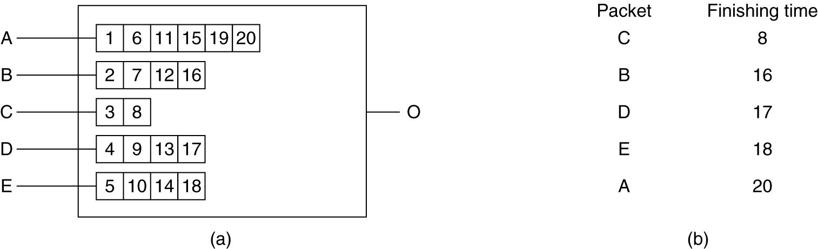
Example
FIFO (per-packet) -> Fair queueing (per-bit)
(a) A router with five packets queued for line O.
(b) Finishing times for the five packets.

Slide 15
Buffer Management
Drop strategy: Which packet to drop when buffers full
Fairness: protect behaving sources from misbehaving ones
Aggregation:
Per-flow buffers protect flows from misbehaving flows
Full aggregation provides no protection
Aggregation into classes provides intermediate protection
Drop priorities:
Drop packets from buffer according to priorities
Maximizes network utilization & application QoS
Examples: layered video, policing at network edge
Controlling sources at the edge

Slide 16
Random Early Detection (RED)
Random early detection (RED):
Early drop: discard packets before buffers are full; drop packets if short-term average of queue exceeds threshold
Packet drop probability increases linearly with queue length
Random drop causes some sources to reduce rate before others, causing gradual reduction in aggregate input rate
Packets produced by TCP will reduce input rate in response to network congestion
Improves performance of cooperating TCP sources
Increases loss probability of misbehaving sources
Notes:
RED, is a buffer management technique that drops packets if queue length exceeds a given threshold.

Slide 17
Packet Drop Profile in RED
Algorithm:
Maintain running average of queue length
If Q_{avg} < minthreshold, do nothing
If Q_{avg} > maxthreshold, drop packet
If in between, drop packet according to probability
Flows that send more packets are more likely to have packets dropped
1
Probability of packet drop
0
full
min_{th}
max_{th}
Average queue length
Notes:
Packets produced by TCP will reduce input rate in response to network congestion

Slide 18
Unit 03.04.03 CS 5220: COMPUTER COMMUNICATIONS
Flow Level: Leaky Bucket Policing
XIAOBO ZHOU, Ph.D.
Professor, Department of Computer Science

Slide 19
Why Congestion?
Congestion
3
6
Approaches to Congestion Control:
Preventive Approaches (open - loop)
Reactive Approaches (closed - loop)
1
4
8
2
5
7

Slide 20
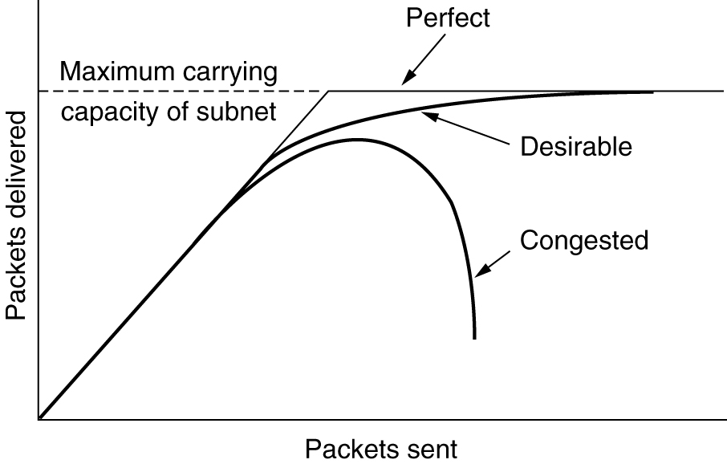
Ideal Effect of Congestion Control
Approaches to Congestion Control:
Preventive Approaches (open - loop)
Reactive Approaches (closed - loop)
Notes:
The purpose of traffic management at the flow level is to control the flows of traffic and maintain performance even in the presence of traffic congestion.
The process is called congestion control, which aims to achieve desirable performance as illustrated in the figure.
There are two main categories of approach.
One is called Preventive Approach. That is open-loop, based on scheduling and resource reservation.
The other is called a Reactive Approach. That it is closed-loop, based on detection and discarding.

Slide 21
Open-Loop Control
Network performance is guaranteed to all traffic flows that have been admitted into the network
Initially for connection-oriented networks
Key Mechanisms
Admission Control
Policing
Traffic Shaping
Notes:
Admission control
Policing – Leaky bucket policing
Traffic shaping – Token bucket

Slide 22
Admission Control
Flows negotiate contract with network
Specify requirements:
Peak, Avg., Min Bit rate
Maximum burst size
Delay, Loss requirement
Network computes resources needed
“Effective” bandwidth
If flow accepted, network allocates resources to ensure QoS delivered as long as source conforms to contract
Peak rate
Bits/second
Average rate
Time
Typical bit rate demanded by a variable bit rate information source

Slide 23
Policing
Network monitors traffic flows continuously to ensure they meet their traffic contract
When a packet violates the contract, network can discard or tag the packet giving it lower priority
If congestion occurs, tagged packets are discarded first

Slide 24
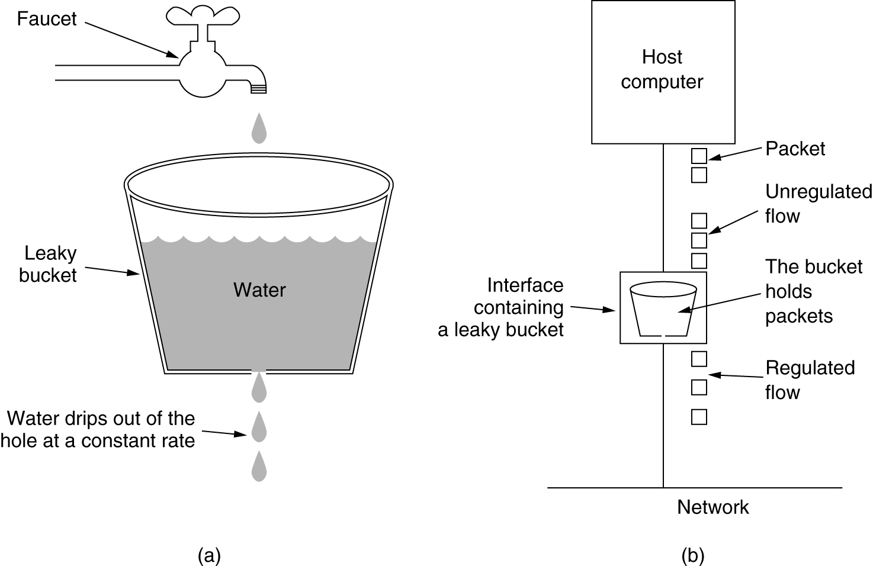
Leaky Bucket Illustration
water poured
irregularly
(a) A leaky bucket with water. (b) a leaky bucket with packets.

Slide 25
Leaky Bucket in ATM Network
ATM Network
All packets are of same fixed length
A counter records the content of the leaky bucket.
When a packet arrives the counter is increased by ‘l’ if bucket would not exceed the limit, packet is conforming
Value l indicates the nominal inter-arrival time of packets being policed

Slide 26
Summary: Leaky Bucket Example
I = 4 L = 6
Nonconforming
Packet
arrival
t1
t5
t7
Time
L+I
Bucket
content
I
t1
t5
t7
Time
*
*
*
*
*
*
*
*
*
Non-conforming packets not allowed into bucket & hence not included in calculations
maximum burst size (MBS = 3 packets)

Slide 27
Unit 03.04.04 CS 5220: COMPUTER COMMUNICATIONS
Traffic Shaping by Token Bucket
XIAOBO ZHOU, Ph.D.
Professor, Department of Computer Science

Slide 28
Flow-level Traffic Shaping
Traffic shaping refers to the process of altering a traffic flow to ensure conformance
A traffic shaping device is often located at the node just before traffic flow leaves network
A traffic policing device is usually located at the node that receives the traffic flow from a network

Slide 29
Leaky Bucket Traffic Shaper
Size N
Incoming traffic
Shaped traffic
Server
Packet
Buffer incoming packets
Play out periodically to conform to parameters
Surges in arrivals are buffered & smoothed out
Possible packet loss due to buffer overflow
Restrictive, not allowing any variable-rate outgoing traffic

Slide 30
Token Bucket Traffic Shaper
Tokens arrive
periodically
An incoming packet must have sufficient tokens before admission into the network
Size K
Token
Size N
Incoming traffic
Shaped traffic
Server
Packet
Token rate regulates transfer of packets
If sufficient tokens available, packets enter network without delay
K determines how much burstiness allowed into the network

Slide 31
Token Bucket Shaping Effect (full)
b + r t
The token bucket constrains the traffic from a source to be limited to b + r t bits in an interval of length t
b bytes instantly
r bytes/second
t
Q1: what are two main differences of a leaky bucket and a token bucket?
Allow saving for burst spending; packet discarding or not.
Q2: When a token bucket is the same as a leaky bucket?
b = 0; but still different indeed: packet discarding or not

Slide 32
Token Bucket Shaping Effect (empty)
Behavior of the token bucket shaper is similar to that of the leady bucket shaper
If the bucket size is reduced to zero, they are identical

Slide 33
Closed-Loop Flow Control
Congestion control
Feedback information to regulate flow from sources into network
Based on buffer length, link utilization, etc.
Examples: TCP at transport layer; congestion control at ATM level
End-to-end vs. Hop-by-hop
Delay in effecting control
Implicit vs. Explicit Feedback
Source deduces congestion from observed behavior
Routers/switches generate messages alerting to congestion

Slide 34
E2E vs. H2H Congestion Control
Source
Packet flow
Destination
(a)
TCP vs. ATM
Source
Destination
(b)
Feedback information

Slide 35
Congestion Warning
The Warning Bit in ACKs
Choke packets to the source
A time-out due to missing acknowledgement

Slide 36
Aggregate Level - Traffic Engineering
Management exerted at flow aggregate level
Distribution of flows in network to achieve efficient utilization of resources (bandwidth)
Must take into account aggregate demand from all flows
“Traffic Engineering”, at scale of minutes to days

